Slide 1

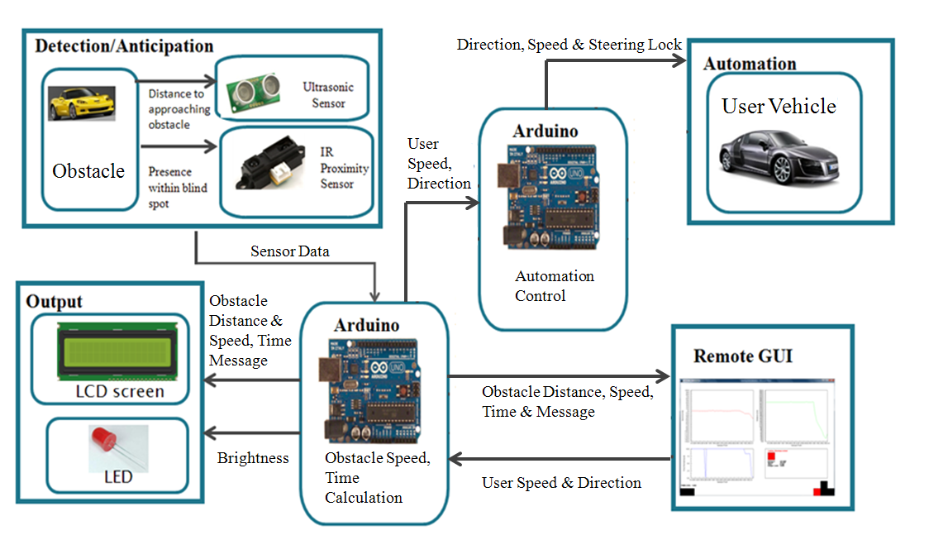
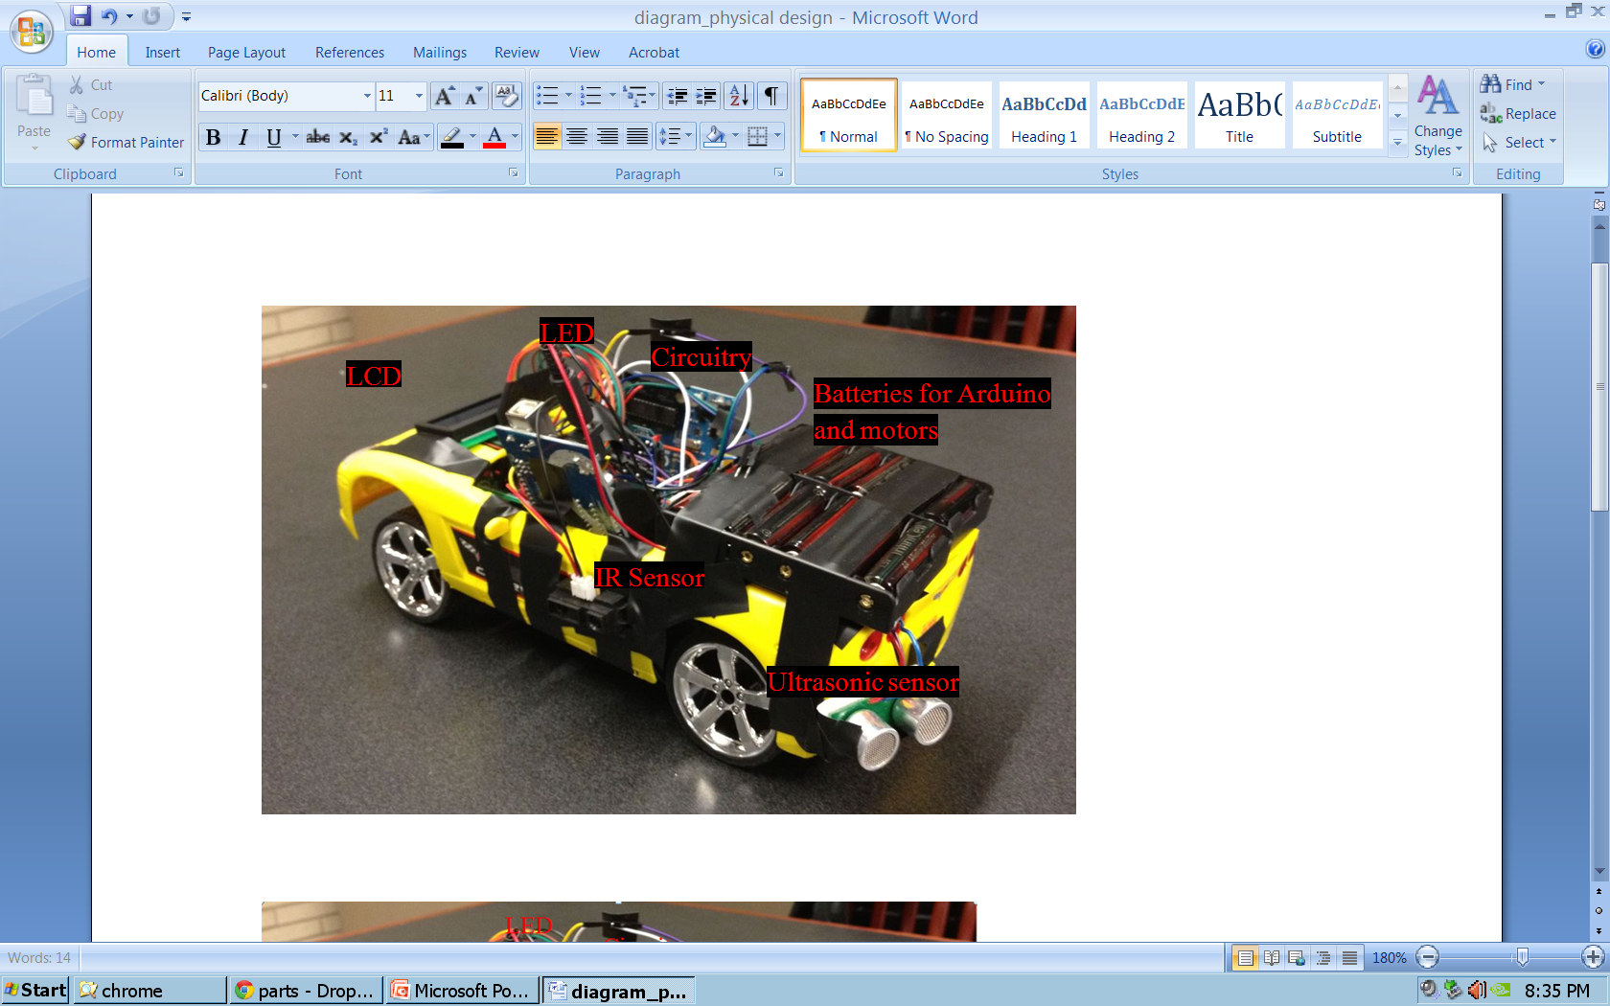
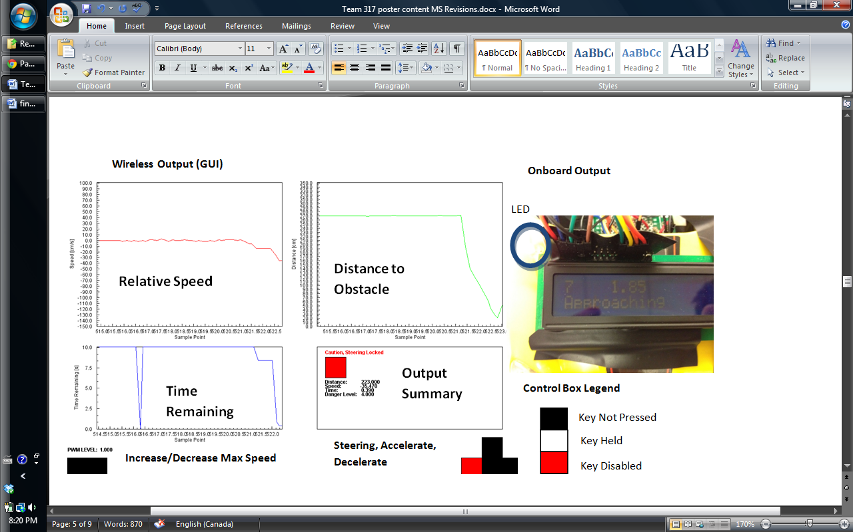
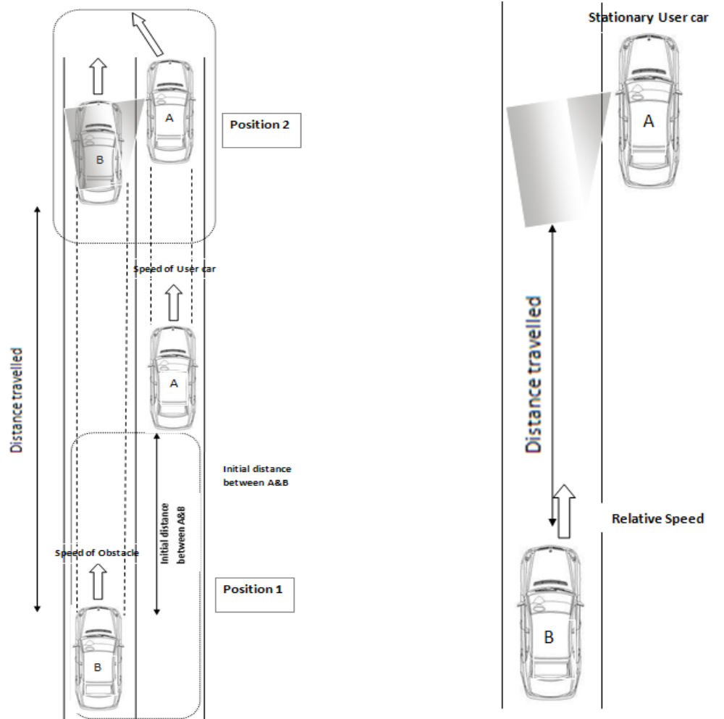
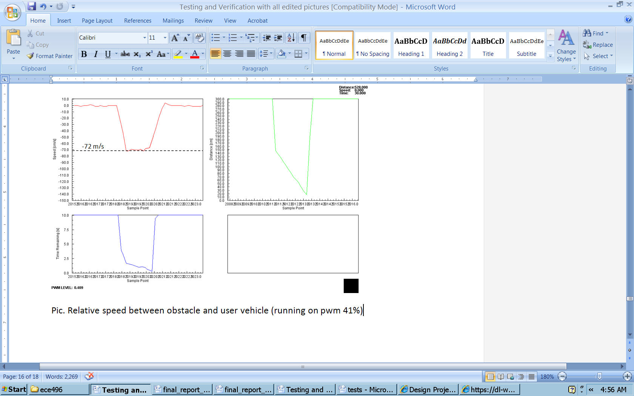
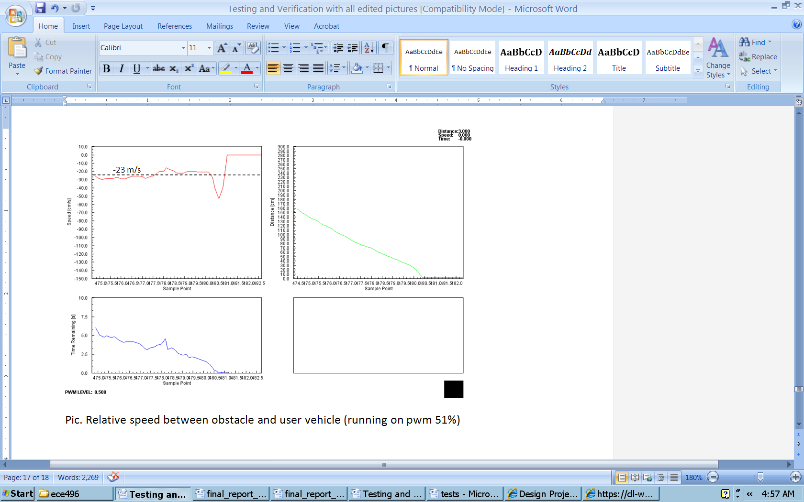
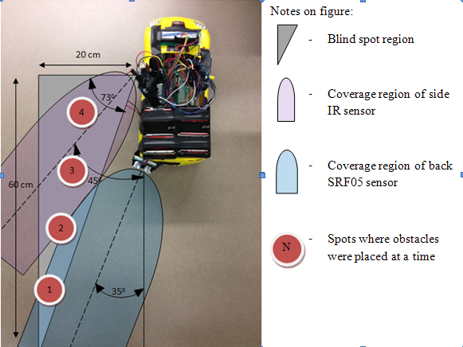
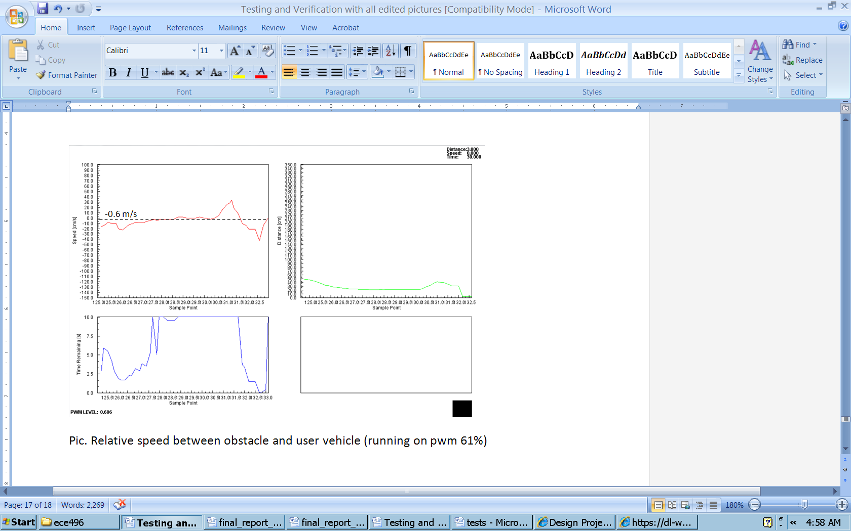
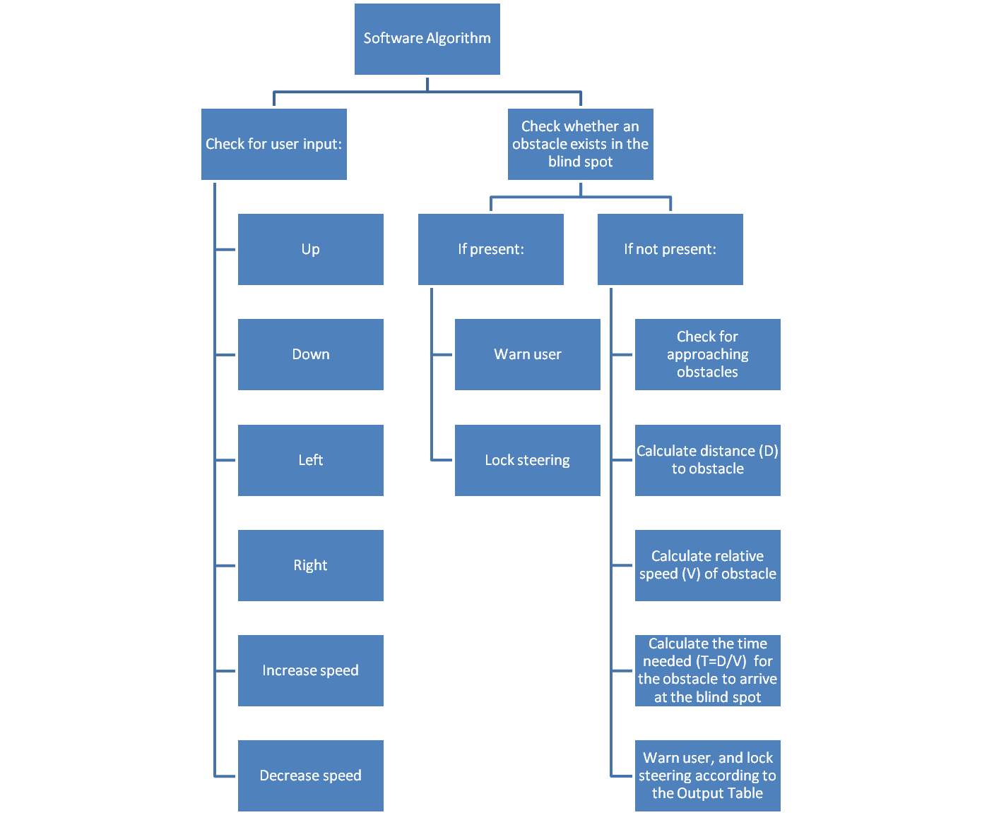
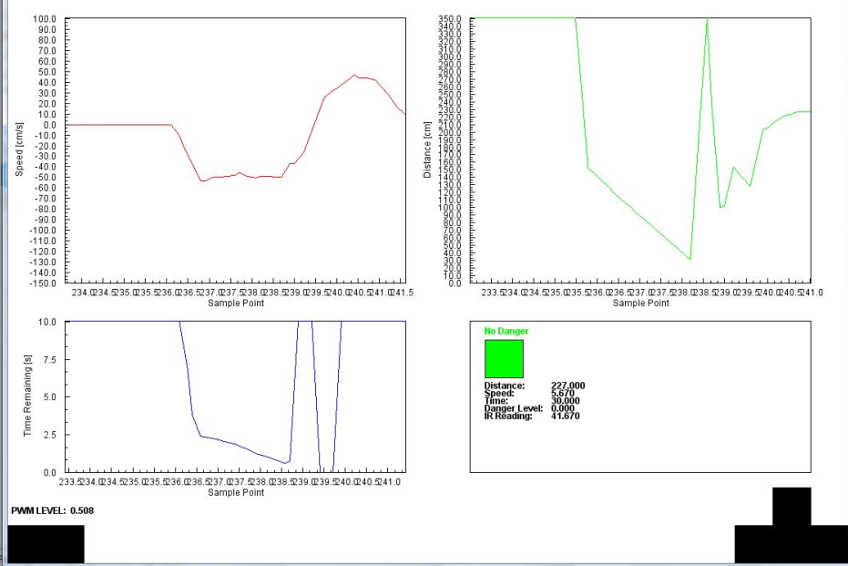
Vehicle Blind Spot Assist # 2011317
Hani Hadidi, Valikhan Kuparov, Tanzim Mokammel
Prof. M. Stickle, Ross Gillett, section 7
System Level Overview
Physical Design
Motivation
Accident during lane changes are common due to driver’s not checking their Blind Spots
Companies such as BMW, Volvo etc have implemented blind spot assist devices on their models, however, universal devices are not widely available
Accident rates are decreasing as safety technology becomes more of a concern, but there’s room for improvement
Project Goal
Assist in accident prevention through a device that will help users identify and anticipate obstacles in their vehicle’s blind spot
Provide an additional level of accident prevention through the implementation of an automated steering lock feature based on relative danger levels
Output Design
Proposed Concept
Obtain distance between user car, and obstacle car
Calculate the relative speed between the two vehicles
Calculate how long the obstacle will take to go from position 1 to position 2 (time remaining)
Provide lane change advice to the user based on the time remaining value
Lock the user vehicle’s steering if the time is too low
Module Level Tests
Speed Tests
Distance Tests
Danger Levels and Output Table
Test | User Vehicle PWM % | Measured Relative speed, [cm/s] | Calculated Relative Speeds, [cm/s] | Error % | Result [Speed vs. Sample Point]
1 | 41% | 75.78 | 72.00 | 5.20
2 | 51% | 24.14 | 23.00 | 4.90
3 | 61% | -0.60 | -0.6 | 0.00
Ultrasonic
Infrared
Actual distance (cm) | Test Result (cm) | Error, %
5 | 5 | 0.00
1 | 101 | 1.00
2 | 201 | 0.50
3 | 300 | 0.00
Actual Distance (cm) | Test Result | Error, %
7.00 | 7.20 | 2.70
12.00 | 12.08 | 0.60
20.00 | 20.26 | 1.30
Situation | Time Left [s] | Danger Level | LCD Screen Output | LED Output
No Danger | t > 15 | 0 | Distance to obstacle, “No Danger” | Off
Obstacle Approaching | 11 < t < 15 | 1 | Distance to obstacle, relative speed, “Obstacle Approaching” | Brightness from 0% to 78%, depending on increasing distance
Obstacle Approaching | 6 < t < 11 | 2
Obstacle Approaching | 3 < t < 6 | 3
Obstacle Very Near | t < 3 | 4 | Distance to obstacle, relative speed, “Caution” | Fully On
Obstacle at Blind Spot | t ≤ 0 | 5 | “Danger, Check Blind Spot” | Fully On + Steering Lock
Blind Spot Coverage Test
Algorithm Design
System Level Test
System Level Test
Objective: | Device should accurately determine danger levels, and lock the steering accordingly
Test Setup | Obstacle car and user car run with different known speeds Relative speed, distance and remaining time plots are observed For cases where time remaining was below the threshold, or an obstacle was already present in the blind spot, successful steering lock was observed
Feedback & Observations | Distance, Speed and time are calculated accurately; user is unable to collide into obstacle as the steering is locked when time remaining falls below the specified threshold
Conclusions and Future Work
The prototype meets the initial objectives within a scaled down environment
With advanced sensors and algorithm optimizations the detection/anticipation component of the device can be implemented on real vehicles
Improvements can be made to:
  Noise filtering algorithms
  Response time of the device
Acknowledgements
Micah Stickel, Ross Gillett, Khoman Phang, Lawrence Chan, Mike Mehrniz

